Slide 1
T24 – Subroutine Guide
Notes:
© 2006 Capgemini - All rights reserved
© 2006 Capgemini - All rights reserved

Slide 2
Objective:
At the end of the session, Participants will know the following:
  Various in-built subroutines that are frequently used
  Usage of the subroutine
  Application of the subroutines

Slide 3
Introduction:
This guide contains a list of the subroutines that are frequently used by T24 application, and those most frequently used by developers.
The routines not documented may be amended by Temenos and functionality and availability may change in future release.
Hence the use of undocumented subroutines may result in detrimental effect on local system and also results in error in the core system.

Slide 4
Steps to be followed before running subroutine:
Compile the routine.
Make a PGM entry with M or S as type, and EB as product.
Log off and Log in into T24.
Run the routine.

Slide 5
Commands:
  Date Routines:
    CDD
    CDT
    CFQ
    DIETER.DATE
    JULDATE
  Exchange Rates:
    CALC.ERATE.LOCAL
    CUSTRATE
    EXCHRATE
    MIDDLE.RATE.CONV.CHECK
  Validation:
    DUP
    STORE.END.ERROR
    ERR

Slide 6
Commands
  4. OVERRIDES:
    STORE.OVERRIDE
  5. Generic:
    CALCULATE.CHARGE
    EB.GET.ACCT.BALANCE
    EB.ROUND.AMOUNT
    GET.STANDARD.SELECTION.DETS
    CHECK.ROUTINE.EXIST
  6. Printing:
    PRINTER.ON
    PRINTER.OFF
    SPOOL.REPORT

Slide 7
CDD:
Description : This routine is used to calculate the difference between two supplied dates, in days.
Arguments:
(REGION, DATE1, DATE2, DAYS)
Incoming:
REGION -> Region code, DATE1 -> Start date, in YYYYMMDD
DATE2 -> End date, in YYYYMMDD
DAYS -> 'W' to indicate working days, 'C' to indicate calendar days
Returned:
DAYS -> Difference in days. Either in + or -.

Slide 8
CDD:
Example:
PROGRAM CDD.PRG
Y.REGION=""
Y.DATE1="20071101"
Y.DATE2="20081101"
Y.DAYS=“C"
CALL CDD(Y.REGION,Y.DATE1,Y.DATE2,Y.DAYS)
PRINT "THE DIFFERNCE BETWEEN “:Y.DATE1:” AND “ :Y.DATE2: “IN DAYS IS ":Y.DAYS
END

Slide 9
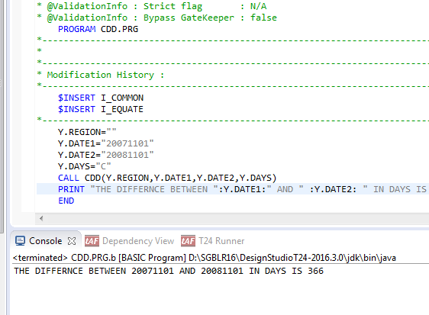
CDD:
Output:

Slide 10
CDT:
Description : This routine is used to calculate the forward or previous date from a start date using the number of days.
Arguments:
(REGION, DATE, DAYS)
Incoming:
REGION -> Region code, DATE -> Start date, YYYYMMDD
DAYS -> The number of days forward in the format + or -, the number of days, working or calendar e.g. +99C, -6W, +66W+3C
Returned:
DATE -> The calculated date
ETEXT -> Error message, if unsuccessful.

Slide 11
CDT:
Example:
PROGRAM CDT.PRG
Y.REGION=""
Y.DATE1="20071101"
Y.DAYS=“99C”
CALL CDT(Y.REGION,Y.DATE1,Y.DAYS)
PRINT "THE NO OF DAYS FORWRD BY 99 IS ":Y.DATE1
END

Slide 12
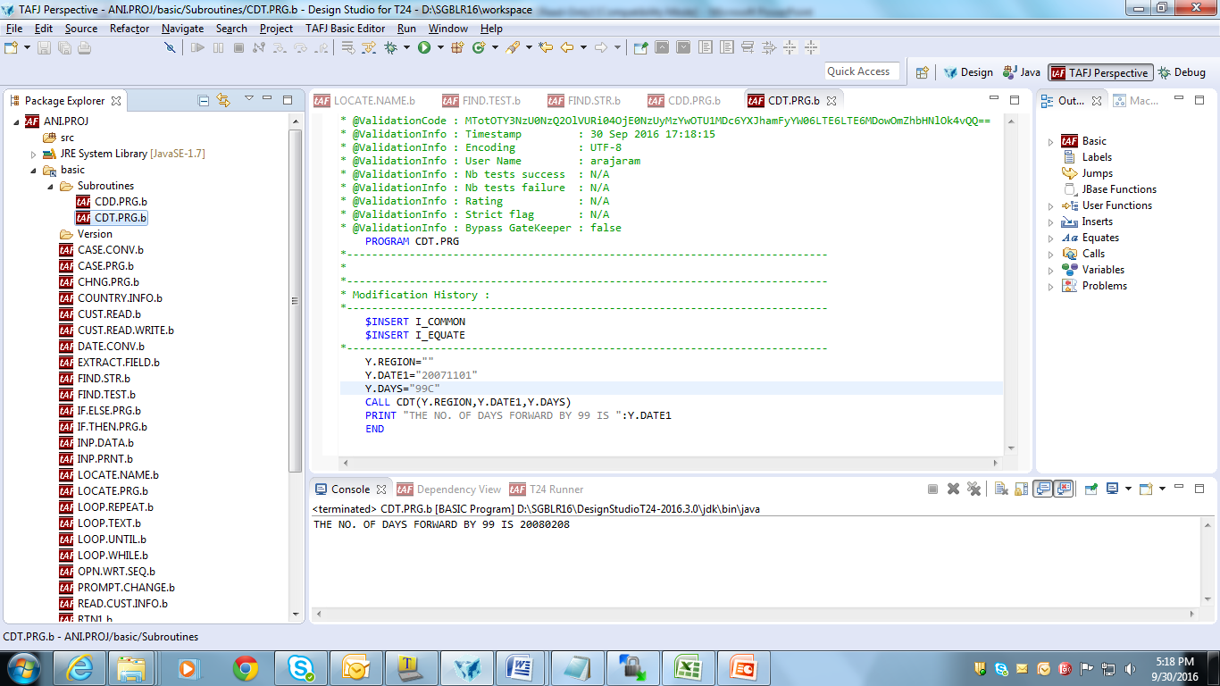
CDT:
Output:

Slide 13
CFQ:
Description : This routine is used to calculate the next date from today's date and a frequency code.
Arguments:
Nil
Incoming:
COMI YYYYMMDDXXXXX, where YYYYMMDD -> input date and XXXXX -> frequency code.
Returned:
COMI YYYYMMDDXXXXX i.e. the calculated date and the frequency code.

Slide 14
CFQ:
Example:
SUBROUTINE CFQ.RTN
$INSERT I_COMMON
$INSERT I_EQUATE
COMI = ‘20080711M0301’
CALL CFQ
PRINT “THE NO OF DAYS POSTPONED FROM THE INPUT DATE IS “: COMI
END

Slide 15
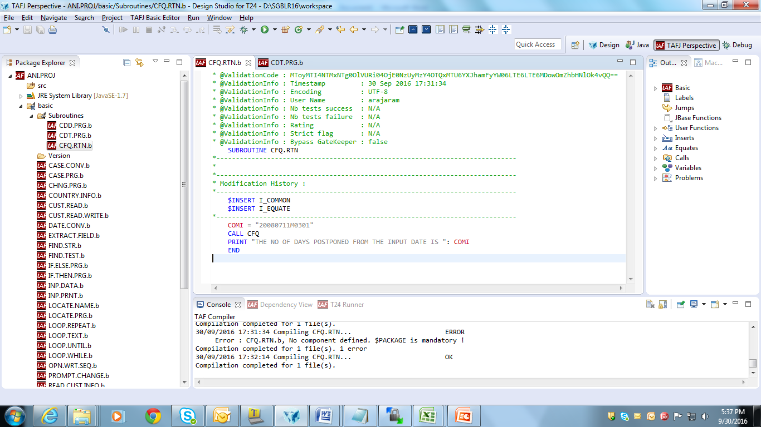
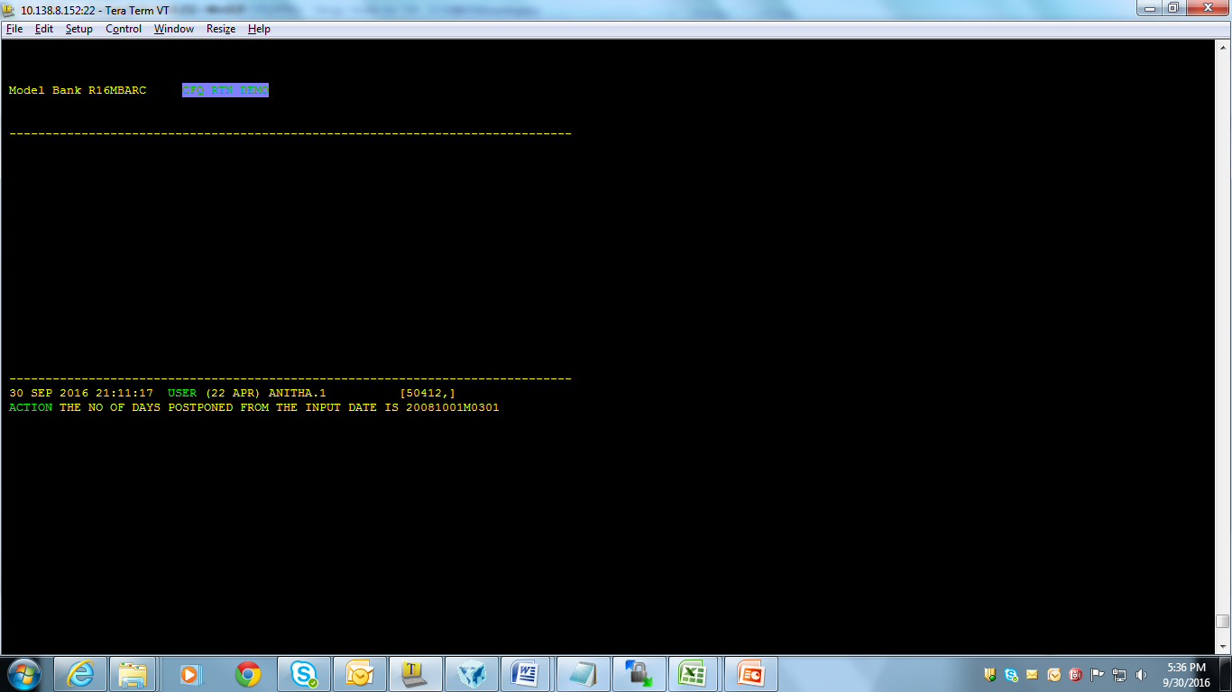
CFQ:
Output:

Slide 16
DIETER.DATE:
Description : This routine is used to convert dates from the format used throughout GLOBUS (YYYMMDD) to the standard jBASE format (either internal or external, where the external dates are formatted as per jBASE CONVERSIONs).
Arguments:
GLOBUS.DATE, jBASE.DATE, CONVERSION
Incoming:
GLOBUS.DATE -> Date in Standard T24 Format (yyyymmdd)
JBASE.DATE -> Date in internal jBASE date format, or formatted
CONVERSION -> Any valid jBASE Date conversion
Returned:
GLOBUS.DATE -> Date in standard T24 format (yyyymmdd)
JBASE.DATE -> Date in internal jBASE date format, or formatted

Slide 17
DIETER.DATE:
Example:
PROGRAM DIETEREX.RTN
G.DATE="20070213"
J.DATE=""
CALL DIETER.DATE(G.DATE,J.DATE,"D")
PRINT "THE D FORMAT OF ":G.DATE:"IS ":J.DATE
G.DATE="20070213"
J.DATE=""
CALL DIETER.DATE(G.DATE,J.DATE,"DD")
PRINT "THE DD FORMAT OF ":G.DATE:"IS ":J.DATE
G.DATE="20070213"
J.DATE=""
CALL DIETER.DATE(G.DATE,J.DATE,"WA")
PRINT "THE WA FORMAT OF ":G.DATE:"IS ":J.DATE
END

Slide 18
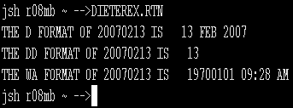
DIETER.DATE:
Output:

Slide 19
JULDATE:
Description : This routine is used to convert from Julian to Gregorian date format and vice versa.
Arguments:
GREGORIAN.DATE,JULIAN.DATE
Incoming:
GREGORIAN.DATE -> Standard T24 Date in the format yyyymmdd
JULIAN.DATE -> Julian Date in the format yyyyjjj
Returned:
GREGORIAN.DATE -> Standard T24 Date in the format yyyymmdd
JULIAN.DATE -> Julian Date in the format yyyyjjj if the incoming is passed as null

Slide 20
JULDATE:
Examples:
PROGRAM JULIAN.PRG
G.DATE="19670101"
J.DATE=""
CALL JULDATE(G.DATE,J.DATE)
PRINT "THE DD FORMAT OF ":G.DATE:"IS ":J.DATE
G.DATE="19680101"
J.DATE=""
CALL JULDATE(G.DATE,J.DATE)
PRINT "THE DD FORMAT OF ":G.DATE:"IS ":J.DATE
G.DATE="20080507"
J.DATE=""
CALL JULDATE(G.DATE,J.DATE)
PRINT "THE DD FORMAT OF ":G.DATE:"IS ":J.DATE
END

Slide 21
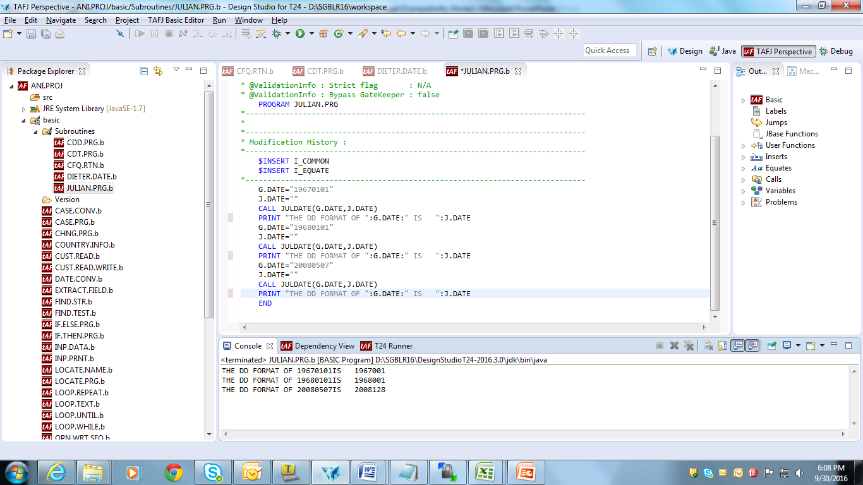
JULDATE:
Output:

Slide 22
CALC.ERATE.LOCAL:
Description : This routine is used to calculate an exchange rate given a foreign amount and local currency equivalent.
Arguments:
YLCL.AMT, YFOR.CCY, YFOR.AMT, YEXCH.RATE
Incoming:
YLCL.AMT -> Local equivalent amount
YFOR.CCY -> Foreign currency
YFOR.AMT -> Foreign Currency amount
Returned:
YEXCH.RATE ->The derived exchange rate

Slide 23
CALC.ERATE.LOCAL:
Example:
SUBROUTINE CALC.ERATE.LOCAL.RTN
YLCL.AMT=6500
YFOR.CCY="GBP"
YFOR.AMT=600
YEXCH.RATE=0
CALL CALC.ERATE.LOCAL(YLCL.AMT,YFOR.CCY,YFOR.AMT,YEXCH.RATE)
PRINT "THE EX RATE FOR LCL AMT “:YLCL.AMT:” EQU OF A FORIEGN CURRENCY IS ":YEXCH.RATE
RETURN
END

Slide 24
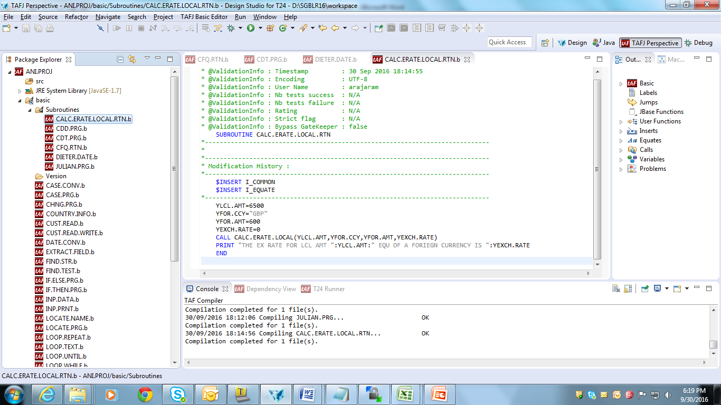
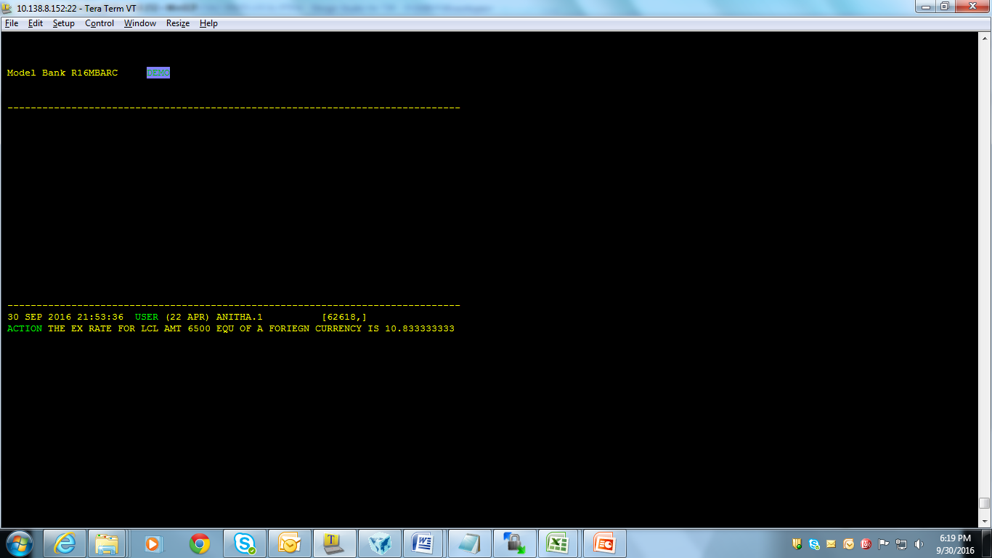
CALC.ERATE.LOCAL:
Output:

Slide 25
CUSTRATE:
Description : This routine is used to Perform all the tasks involved in foreign exchange of two currencies on a buy/sell basis
Arguments:
CCY.MARKETS, BUY.CCY, BUY.AMT, SELL.CCY, SELL.AMT, BASE.CCY, TREASURY.RATE, CUST.RATE, CUST.SPREAD, SPREAD.PCT, LOCAL.CCY.BUY, LOCAL.CCY.SELL, RETURN.CODE

Slide 26
CUSTRATE:
Incoming:
CCY.MARKETS | Multi-valued field containing markets for buy and sell side. The markets are separated by value marker (VM).
BUY.CCY & SELL.CCY | Currencies involved in the transaction.
BUY.AMT & SELL.AMT | Amount involved in the transaction. Only one is passed to routine, while the other is calculated.
BASE.CCY | Currency in terms of which rate is expressed.
TREASURY.RATE | Rate at which treasury will exchange currency.
CUSTOMER.RATE | Rate at which currency is exchanged between the customers.
CUSTOMER.SPREAD | Difference between TREASURY.RATE and CUSTOMER.RATE.
SPREAD.PCT | Percentage of default CUSTOMER.SPREAD is to be used in calculating CUSTOMER.RATE.

Slide 27
CUSTRATE:
Returned:
LOCAL BUY/SELL AMTS | Local equivalent of buy and sell amount involved in the transaction.
RETURN.CODE | Holds status of various tests performed during the routine execution. The dynamic array of the return codes is composed of the following fields: 1 -> Invalid input parameter. 2 -> Negotiable amount exceeded. 3 -> Fixing date error. 4 -> Suspended market.

Slide 28
CUSTRATE:
Example:
SUBROUTINE CUSTRATE.RTN
$INSERT I_COMMON
$INSERT I_EQUATE
CCY.MARKETS=1:VM:10
BUY.CCY="USD"
BUY.AMT=100
SELL.CCY="GBP"
SELL.AMT=""
BASE.CCY="USD"
TREASURY.RATE= ‘’
CUST.RATE=25
CUST.SPREAD=’’
SPREAD.PCT=""
LOCAL.CCY.BUY=""
LOCAL.CCY.SELL=’’

Slide 29
CUSTRATE:
RETURN.CODE=""
PRINT ETEXT
CALL CUSTRATE(CCY.MARKETS,BUY.CCY,BUY.AMT,SELL.CCY,SELL.AMT,BASE.CCY,TREASURY.RATE,CUST.RATE,CUST.SPREAD,SPREAD.PCT,LOCAL.CCY.BUY,LOCAL.CCY.SELL,RETURN.CODE)
PRINT "THE LOCAL CURRENCY PURCHASED IS “:LOCAL.CCY.BUY
PRINT "THE RETURN CODE INFORMTION IS ":RETURN.CODE
PRINT ETEXT
CALL STORE.END.ERROR
PRINT ETEXT
INPUT AA
RETURN
END

Slide 30
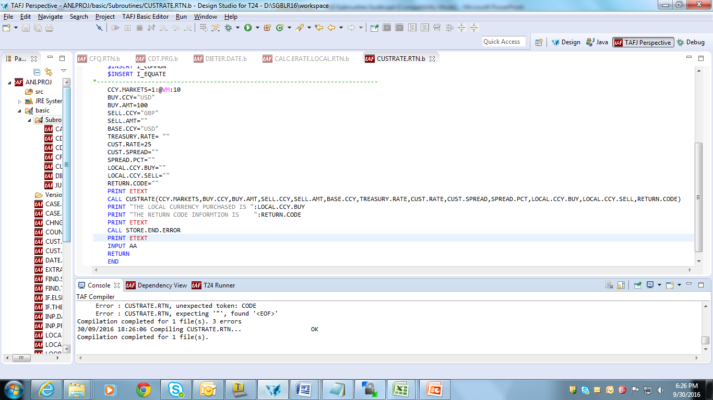
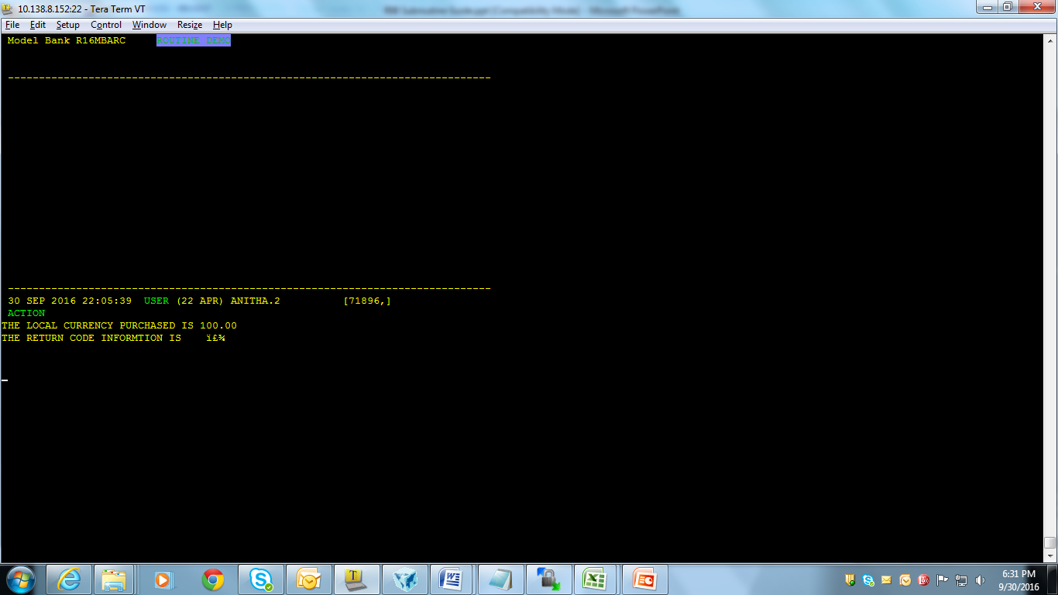
CUSTRATE:
Output:

Slide 31
EXCHRATE:
Description : This routine is used to perform all the task involved in foreign exchange of two currencies.
Arguments:
CCY.MKT, BUY.CCY,BUY.AMT, SELL.CCY, SELL.AMT, BASE.CCY, EXCHANGE.RATE, DIFFERENCE, LCY.AMT,RETURN.CODE
Incoming:
  CCY.MKT, BUY.CCY and SELL.CCY, BUY.AMT and SELL.AMT, BASE.CCY and EXCHANGE.RATE
Returned:
DIFFERENCE, LCY.AMT and RETURN.CODE

Slide 32
EXCHRATE:
Incoming:
CCY.MKT | The currency market in which the transaction will take place
BUY.CCY and SELL.CCY | The currencies that will be involved in the transaction
BUY.AMT and SELL.AMT | The amounts that will be involved in the transaction
BASE.CCY | The currency in terms of which the EXCHANGE.RATE will be expressed
EXCHANGE.RATE | The rate of exchange between the two currencies

Slide 33
EXCHRATE:
Returned:
DIFFERENCE | The difference between the figures given above and the internally generated BASE.CCY amount
LCY.AMT | The amount of the transactions in terms of the local currency
RETURN.CODE | The status of various tests performed during the course of the routine. RETURN.CODE is a dynamic array composed of six fields, which are as follows: 1 -> Invalid input parameter 2 -> Tolerance error 3 -> Negotiable amount exceeded.

Slide 34
EXCHRATE:
Examples:
SUBROUTINE EXCHRATEEX.RTN
CCY.MKT=1
BUY.CCY="GBP"
BUY.AMT=10000
SELL.CCY="USD"
SELL.AMT=""
BASE.CCY="USD"
EXCHANGE.RATE=""
DIFFERENCE=""
LCY.AMT=""
RETURN.CODE=""

Slide 35
EXCHRATE:
CALL EXCHRATE(CCY.MKT, BUY.CCY, BUY.AMT, SELL.CCY, SELL.AMT, BASE.CCY, EXCHANGE.RATE, DIFFERENCE, LCY.AMT, RETURN.CODE)
PRINT "THE EX RATE FOR LCL EQU OF A FORIEGN CURRENCY ":EXCHANGE.RATE
PRINT "THE DIFFERENCE BETWEEN TWO CURRENCIES IS ":DIFFERENCE
PRINT "THE LOCAL CURRENCY AMOUNT IS ":LCY.AMT
PRINT "THE RETURN CODE IS ":RETURN.CODE
PRINT "THE SELL AMOUNT IS ":SELL.AMT
RETURN
END

Slide 36
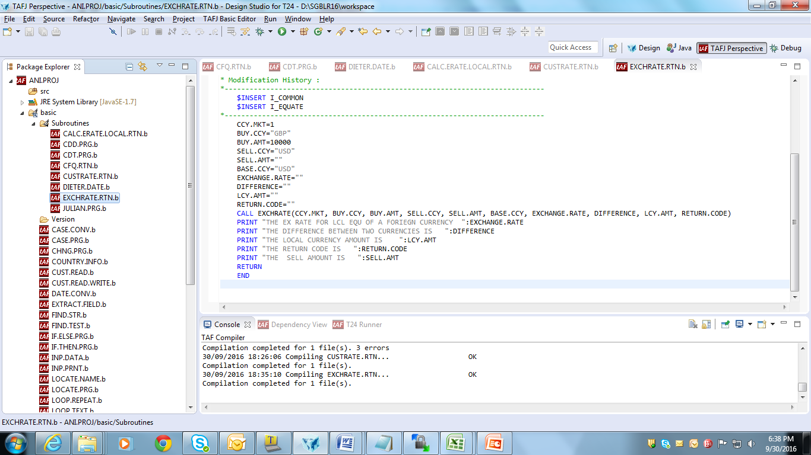
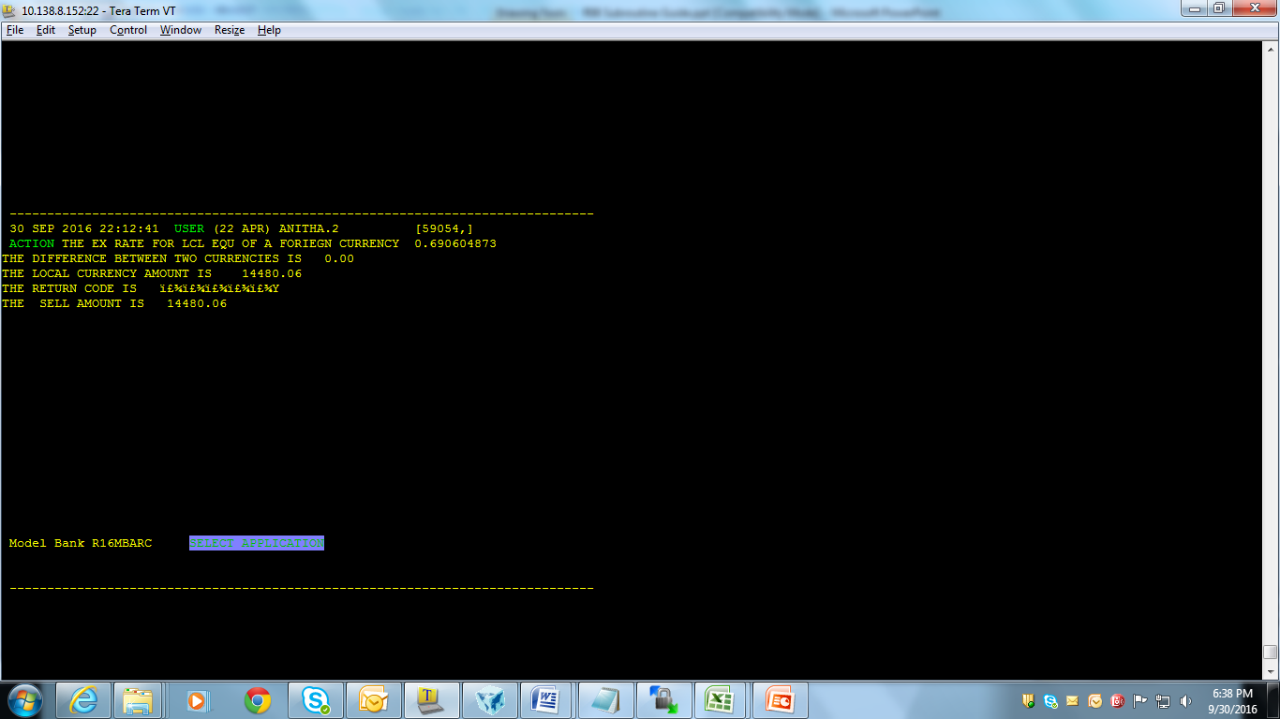
EXCHRATE:
Output:

Slide 37
MIDDLE.RATE.CONV.CHECK:
Description : This routine is used to perform the following functions:
  Converts foreign amount to local amount, when only foreign amount is passed.
  Converts local amount to foreign amount, when only local amount is passed.
  Calculates the exchange rate, when both foreign and local amounts are passed.
  Recalculates foreign and local amounts, and recalculates the difference.
  Calculates percentage exchange rate difference, when a rate is passed.

Slide 38
MIDDLE.RATE.CONV.CHECK:
Arguments:
(FAMT, FCY, RATE, MARKET, LAMT, DIF.AMT, DIF.RATE)
Incoming:
FAMT -> Foreign amount
FCY -> Foreign currency code, USD etc
RATE -> Exchange rate MARKET Currency market (default 1)
LAMT -> Local amount
Returned:
FAMT, LAMT and RATE -> When calculated
DIF.AMT -> Amount difference when calculated
DIF.RATE -> Percentage rate difference when calculated

Slide 39
MIDDLE.RATE.CONV.CHECK:
Examples:
PROGRAM MIDDLE.RATE.CONV.CHECK.PRG
$INSERT I_COMMON
$INSERT I_EQUATE
FAMT=1000
FCY="AED"
RATE=""
MARKET=1
LAMT=""
DIF.AMT=""
DIF.RATE=.5
PRINT ETEXT

Slide 40
MIDDLE.RATE.CONV.CHECK:
CALL MIDDLE.RATE.CONV.CHECK(FAMT,FCY,RATE,MARKET,LAMT,DIF.AMT,DIF.RATE)
PRINT "THE FORIEGN AMOUNT ":FAMT
PRINT "THE LOCAL AMOUNT ":LAMT
PRINT "THE CONVERSION RATE IS ":RATE
PRINT ETEXT
CALL STORE.END.ERROR
PRINT ETEXT
END

Slide 41
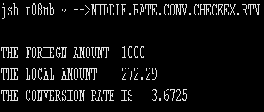
MIDDLE.RATE.CONV.CHECK:
Output:

Slide 42
DUP:
Description : This routine is used to check for duplicate occurrence of values in multi and sub-valued fields at cross validation.
Arguments: NONE
Incoming:
R.NEW(x ) -> Current record
AF -> Field number (x) to be validated
F(x) -> Array containing the field names and definition as multi and/or sub-valued fields
Returned :
END.ERROR -> Error flag indicating cross-validation error
ETEXT, T.ETEXT -> Error message: 'INPUT OR LINE-DELETION MISSING' or 'DUPLICATE'

Slide 43
Workshop:
Check for duplicate occurrence of same currency, when currency is input in parameter table, using DUP.

Slide 44
STORE.END.ERROR:
Description : This routine is used to store the error message by field, where the error message is displayed at the end of validation.
Arguments:
AF -> from I_COMMON
AV -> from I_COMMON
AS -> from I_COMMON
ETEXT -> from I_COMMON
Incoming:
AF -> Field number in error
AV -> Value number in error
AS -> Sub-value in error
ETEXT -> Error message

Slide 45
Workshop:
Display an error message at the end of validation for correct input of account number corresponding to the customer no, in issue table.

Slide 46
ERR:
Description : This routine is used to display the error message on the same line as input or on line number 22 if running under multi-line version. Can be used only with the confines of template program.
Arguments:
E and ECOMI -> From I_COMMON
Incoming:
E -> Error message to be displayed (will be translated)
ECOMI -> Should contain the user input if it is to be displayed with the error message.

Slide 47
Workshop:
Throw an error when input id in issue table is not valid company id.

Slide 48
STORE.OVERRIDE:
Description : This routine is used to prompt for an override and store the message in the main file record if the user replies ‘Y’.
Arguments:
(CURR.NO)
AF, AV, AS and TEXT → from I_COMMON
Incoming:
CURR.NO -> Current record number
AF -> Field number to return to if user replies 'NO‘
AV -> Value number to return to if user replies 'NO'
AS -> Sub-Value to return to if user replies 'NO' TEXT Override message
Returned:
TEXT -> User's reply, 'Y' or 'NO'

Slide 49
Workshop:
Throw an override and store the accepted overrides and display it in a field of issue table or FT transaction.

Slide 50
CALCULATE.CHARGE:
Description : This routine is used to calculate charges, commission and tax amount, and returns enough information to raise accounting entries.
Arguments:
(CUSTOMER, DEAL.AMOUNT, DEAL.CURRENCY, CURRENCY.MARKET, CROSS.RATE, CROSS.CURRENCY, DRAWDOWN.CCY, T.DATA, CUST.COND, TOT.CHARGE.LCCY, TOT.CHARGE.FCCY)

Slide 51
CALCULATE.CHARGE:
Incoming:
CUSTOMER | Customer who has to pay the charge
DEAL.AMOUNT | Deal amount used for percentage charge calculations
DEAL.CURRENCY | Currency of the deal amount
CURRENCY.MARKET | Market to use for currency conversions
CROSS.RATE | Deal rate used in the transaction (optional)
CROSS.CURRENCY | Other currency involved (optional)
DRAWDOWN.CCY | Currency to return the charges in (default deal currency)
T.DATA<1,x> | List of charge, commission and tax codes
T.DATA<2,x> | Optional list of code types, CHG, COM, TAX
CUST.COND | Conditions overriding the default charge tables
CUST.COND<1,x> | Percentage of the charge to be levied
CUST.COND<2,x> | List of currencies and charge amounts to be used
CUST.COND<3,x> | Defined on the charge tables
CUST.COND<4,x> | Customer to be used instead of CUSTOMER

Slide 52
CALCULATE.CHARGE:
Returned:
T.DATA<2,x> | Code types CHG, COM, TAX
T.DATA<3,x> | Category or internal a/c to post the charges to
T.DATA<4,x> | Charge amount in local
T.DATA<5,x> | Charge amount in foreign currency
T.DATA<6,x> | Mid rate used between local and foreign
T.DATA<7,x> | Transaction code for the entry
TOT.CHARGE.FCCY | Total charge to debit the drawdown account
TOT.CHARGE.LCCY | Local equivalent
ETEXT | Any errors encountered

Slide 53
Workshop:
Calculate charges, commission and tax amount, and return enough information to raise accounting entries when issue table is authorized.

Slide 54
EB.GET.ACCT.BALANCE:
Description: This routine is used to return an account balance of a given type on a given date, and to return the balance at a requested system date without adjustments. This routine obtains the balance by using the correct ACCT.ACTIVITY record for the requested date.
Arguments:
ACCT.ID, ACCT.REC, BALANCE.TYPE, BALANCE.DATE, SYSTEM.DATE, BALANCE, CREDIT.MVMT, CREDIT.MVMT, DEBIT.MVMT, ERR.MSG

Slide 55
EB.GET.ACCT.BALANCE:
Incoming:
Returned:
ACCT.ID | Account Number
ACCT.REC | Account record
BALANCE.TYPE | ‘VALUE’, ‘TRADE’ or ‘BOOKING’
BALANCE.DATE | Date balance is required for (YYYYMMDD), will default to Today if left blank
SYSTEM.DATE | Optional date as of system date
BALANCE | Returned balance
CREDIT.MVMT | Returned net credit movement for the date
DEBIT.MVMT | Returned net debit movement for the date
ERR.MSG | Any error messages

Slide 56
EB.GET.ACCT.BALANCE:
Examples:
SUBROUTINE GET.ACCT.BALANCE
$INSERT I_COMMON
$INSERT I_EQUATE
ACCT.ID = 11509
ACCT.REC = 11509
BALANCE.TYPE = ‘VALUE’
BALANCE.DATE = TODAY
SYSTEM.DATE = TODAY

Slide 57
EB.GET.ACCT.BALANCE:
CALL EB.GET.ACCT.BALANCE(ACCT.ID, ACCT.REC, BALANCE.TYPE, BALANCE.DATE, SYSTEM.DATE, BALANCE, CREDIT.MVMT, CREDIT.MVMT, DEBIT.MVMT, ERR.MSG)
PRINT “BALANCE IS “:BALANCE
PRINT “CREDIT MVMT IS “:CREDIT.MVMT
PRINT “DEBIT MVMT IS “:DEBIT.MVMT
PRINT “ERROR :”: ERR.MSG
INPUT AA
END

Slide 58
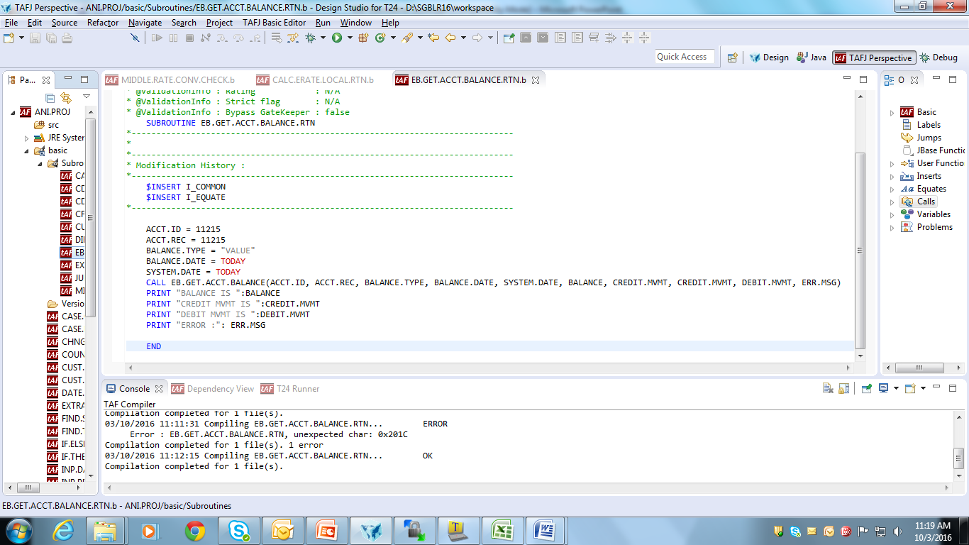
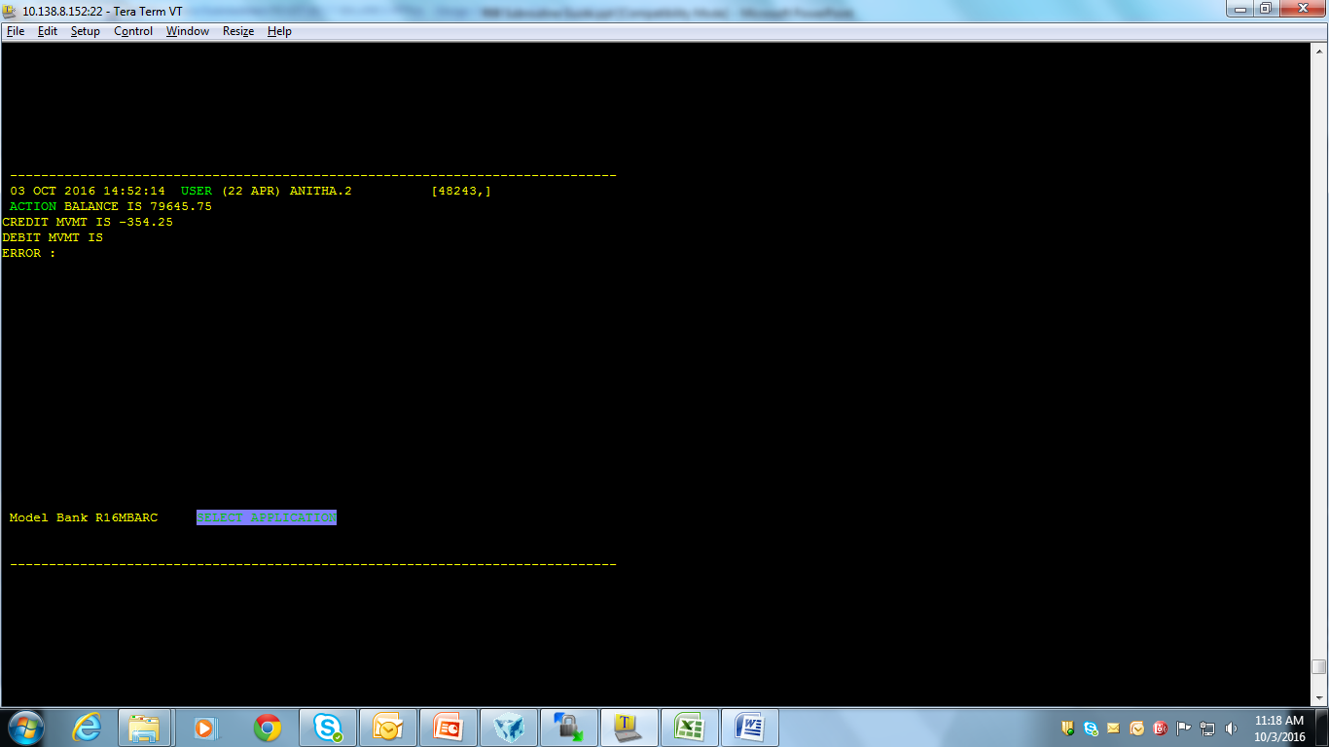
EB.GET.ACCT.BALANCE:
Output:

Slide 59
EB.ROUND.AMOUNT:
Description : This routine is used to format the amount according to current definitions, by:
    Using defaults two decimal places
    Using defined number or decimal places for the currency
    Using the lowest unit of currency and rounding according to lowest unit.
Arguments:
CURRENCY.ID, AMOUNT, CAL, CUSTOMER.ID

Slide 60
EB.ROUND.AMOUNT:
Incoming:
Returned:
AMOUNT -> The amount rounded and formatted according to the currency and CAL specified
CURRENCY.ID | Currency code
AMOUNT | Amount
CAL | “” use lowest currency unit rounding 1 non-cash rounding 2 cash rounding
CUSTOMER.ID | for future use

Slide 61
EB.ROUND.AMOUNT:
Examples
SUBROUTINE ROUND.AMT
$INSERT I_COMMON
$INSERT I_EQUATE
CURRENCY.ID = ‘USD’
AMOUNT = 9997.5684
CAL = 2
CUSTOMER.ID = ‘’
CALL EB.ROUND.AMOUNT(CURRENCY.ID, AMOUNT, CAL , CUSTOMER.ID)
PRINT “THE ROUNDED AMOUNT IS :”: AMOUNT
INPUT AA
END

Slide 62
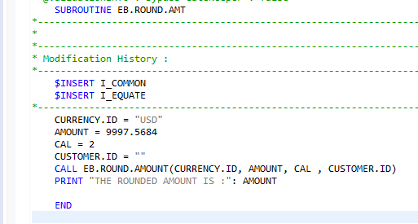
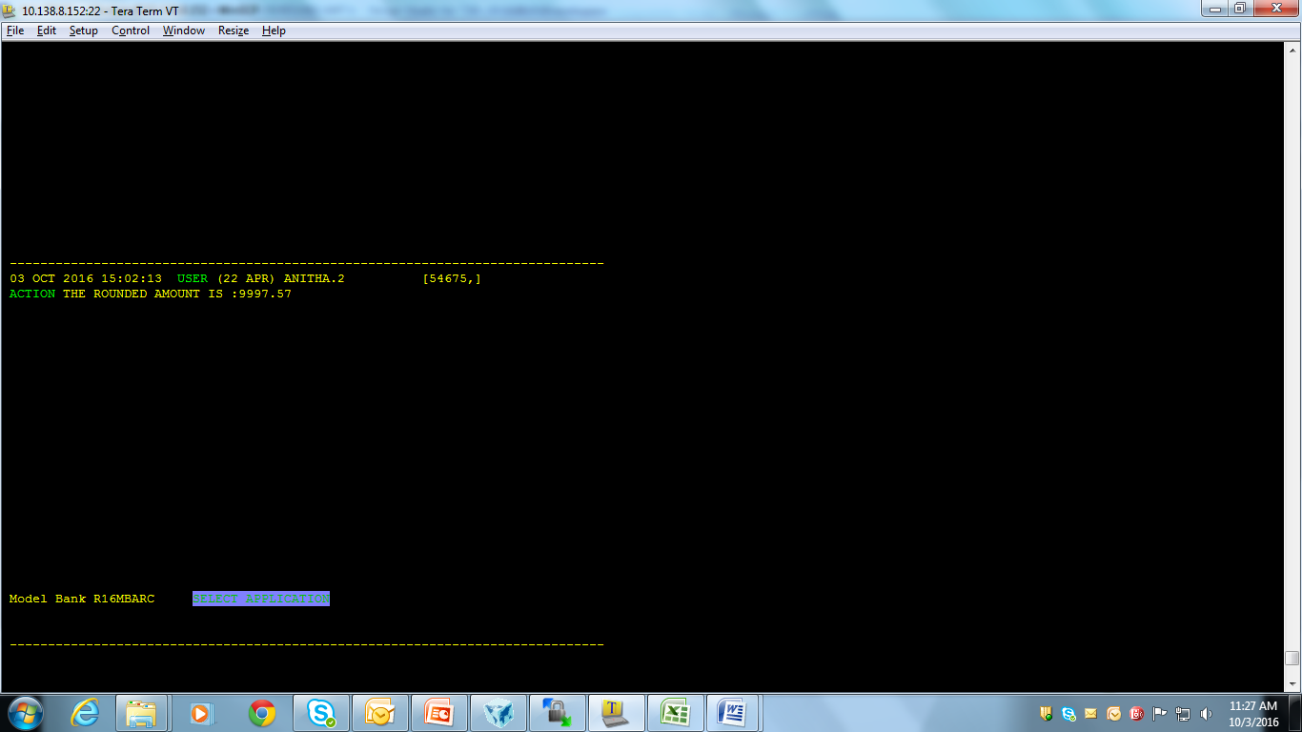
EB.ROUND.AMOUNT:
Output:

Slide 63
GET.STANDARD.SELECTION.DETS:
Description : This routine is used to read the standard selection record and merges the SYS and USR fields. This routine contains a dimensioned cache of the standard selection record T.SS.REC and dynamic list of standard selection ids T.SS.IDs.
Arguments:
STANDARD.SEL.ID, SS.REC
Incoming:
STANDARD.SEL.ID -> Key to STANDARD.SELECTION record
Returned:
SS.REC -> STANDARD.SELECTION record with USR and SYS fields merged into the SYS fields.

Slide 64
GET.STANDARD.SELECTION.DETS:
Examples:
SUBROUTINE STD.SEL.DETS.TEST
$INSERT I_COMMON
$INSERT I_EQUATE
STANDARD.SEL.ID = ‘TH.HO.CHQ.REG’
CALL GET.STANDARD.SELECTION.DETS(STANDARD.SEL.ID,SS.REC)
PRINT “RECORD IS :”: SS.REC
END

Slide 65
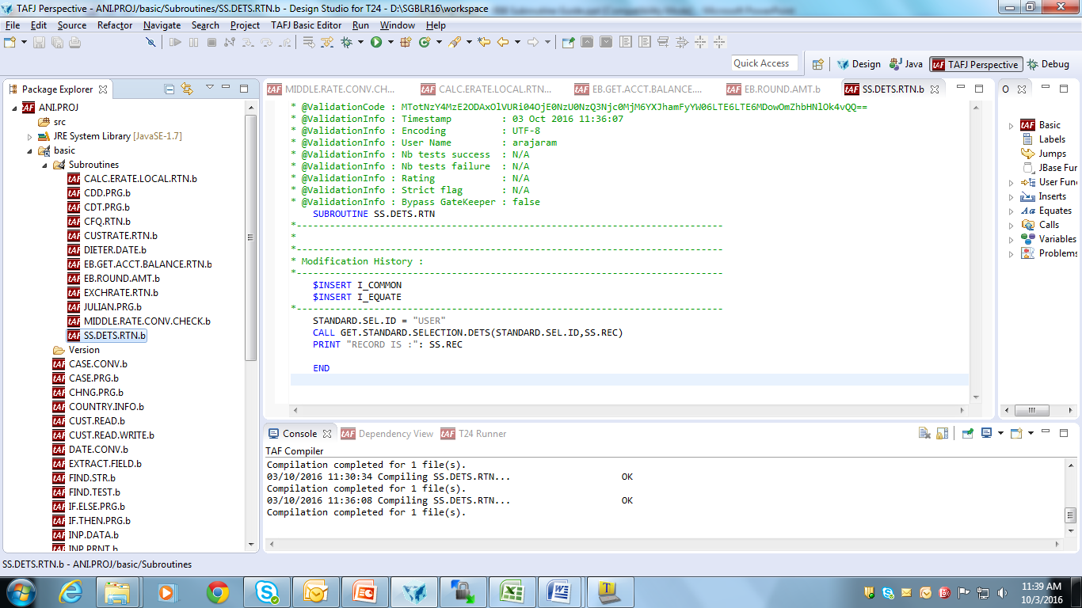
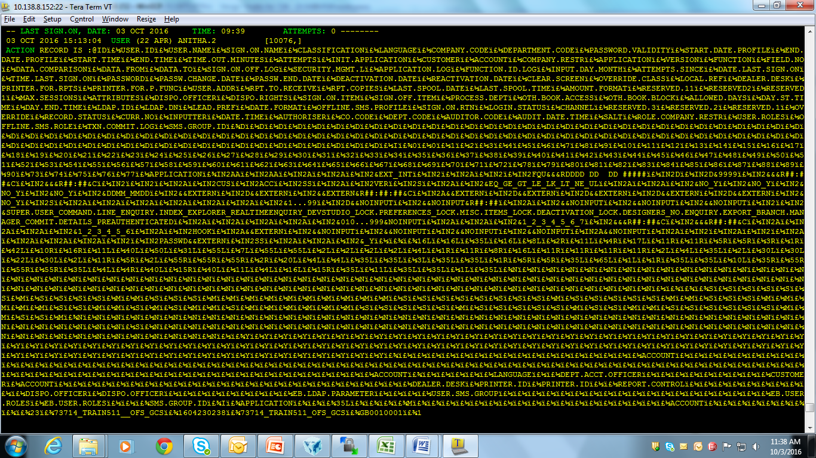
GET.STANDARD.SELECTION.DETS:
Output:

Slide 66
PRINTER.ON:
Description : This routine is used to set up the printer environment for the reports and to direct output to print unit. This routine must be used instead of Data/Basic PRINTER.ON statement.
Arguments:
NAME, UNIT
Incoming:
NAME -> Name of the report as defined on the report control file.
UNIT -> Print unit to which output should be directed. 0 - 254, default 0

Slide 67
Workshop:
Set up a printer environment for printing report containing accounting and customer details at the end of each month.

Slide 68
PRINTER.OFF:
Description : This routine is used to redirect output from print unit to the screen. This routine must be used instead of Data/Basic PRINTER.OFF statement.
Arguments:
NONE

Slide 69
Workshop:
Write a routine to redirect the output from print unit during printing of deal slip to the screen.

Slide 70
SPOOL.REPORT:
Description : This routine is used to spool a report that is not created by the report control system. This is used only with COMO files. This routine must be used instead of executing a spool command.
Arguments:
‘’, NAME, TREE.NAME, ‘’, ‘’, ‘’
Incoming:
NAME -> Name of the report as defined on the report control file.
TREE.NAME -> Path name of the COMO file. This must be in the format 'filename>recordname' e.g. &COMO&>TEST.COMO. The filename must be a valid VOC entry.
"" -> All other arguments must be specified as null (internal use only).

Slide 71
Workshop:
Write a routine to spool and print reports such as delivery message and deal slips created today.

Slide 72


www.capgemini.com/financialservices
Notes:
© 2006 Capgemini - All rights reserved

